Slide 1

Looped Through
Created by Tom Buck

Slide 2
Looped Through - The Idea
Looped Through is a story based game using the idea of restarting days, and solving puzzles using mechanics like recurring days but with picked up items from previous version of that day and making different decisions to get through the story within the quickest possible time…
The game is a single page web app which draws information from a Web API and uses various coding tools

Slide 3
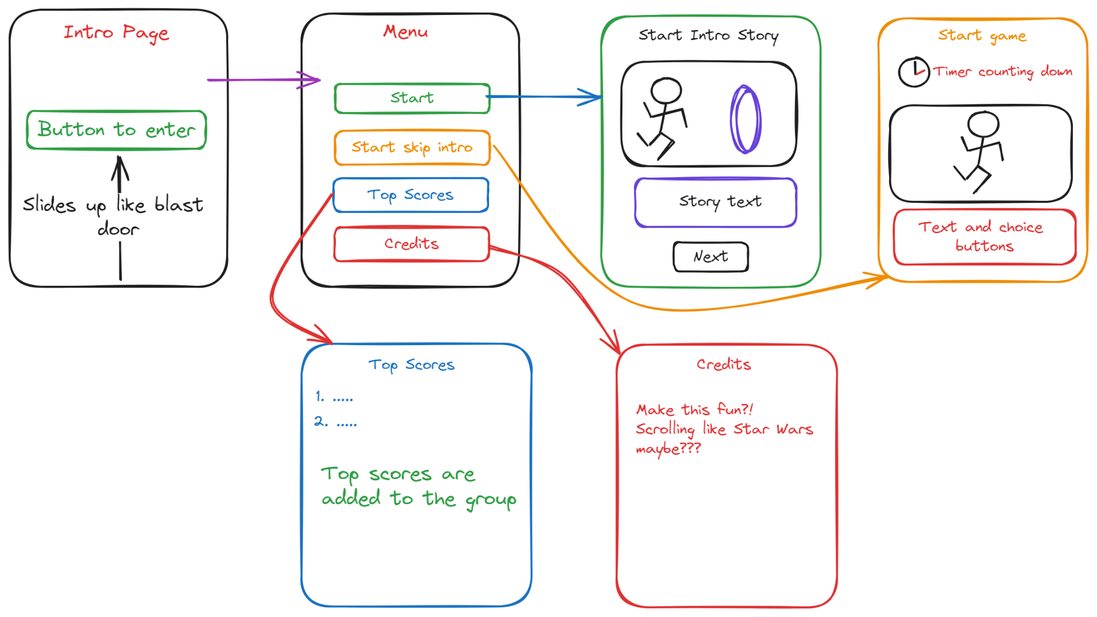
Wire Frames - The Game Screens

Slide 4
Looped Through - Some of the technical features
Credits Scene - Uses react.js with some CSS to make the “Star Wars Crawl effect”
Intro story - Pulls data from C# Web API to set image and text fields within the intro
Can be downloaded from GITHUB - https://github.com/Buckillar/Timeloop.git

Slide 5
Looped Through - Some of the challenges
Writing an entire story!
Which worked within the game, which wasn’t to long, made sense and was grammatically correct
Convincing the Wife to play test
She did a fantastic job of pointing out a lot of grammatical mistakes and missed words, she enjoyed that more than following the test plan.
Learning and using a lot of new coding tools
Learning how to implement react.js, c# and javascript into my website and how to use GIT and GITHUB to commit etc and version control have been really enjoyable but at times tough

Slide 6
Looped Through - Presentation
Now for the main event…

